Slide 3
Profile
Year of Foundation: 2001
Location:
Factory 1
2977/11 National Road 1A, Group 5, Tan Thoi Nhat Ward, District 12, Ho Chi Minh City, Vietnam
Factory 2
Bau Tre 2 , Tan An Hoi ward , Cu Chi Dist , Chi Minh City, Vietnam
Number of employees:
600 people
Total sewing lines:
Factory 1 : 10 lines
Factory 2 : 4 lines
Key production:
All kind of knits such as : T shirt , Hoodies, Leggings, Active wears…
And light fashion such as : Dresses, Skirts, Blouses,
Capacity: 600,000pcs/ month

Slide 5
THAO MINH
ORGARNIZATION CHART

Slide 6
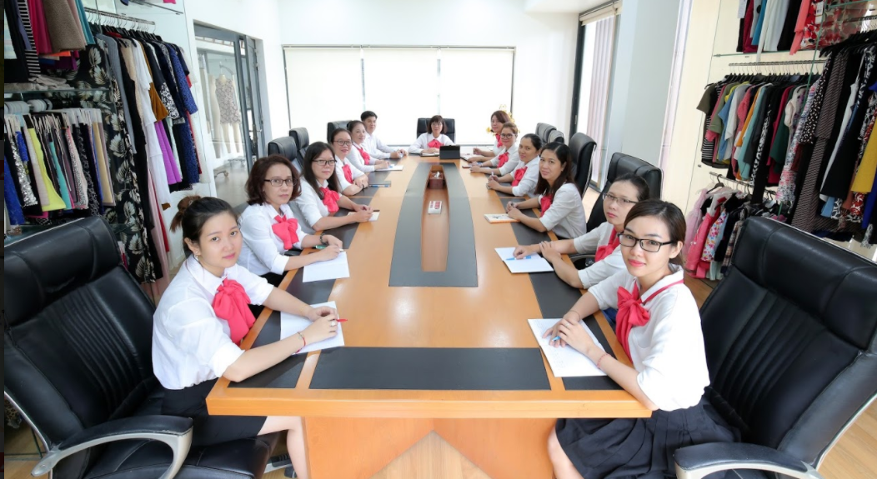
Fabrics and trims Sourcing: We have developed long-standing relationships with fabric and trims suppliers in Vietnam and other Asian countries. Sampling: Our experienced team can develop new patterns and concepts required by customers. Costing: Fast service is one of our core values. We can have costing developed within 24 hours with sharp and competitive prices. Planning and production: Planning is one of the most important aspects of our organization. We undergo complete planning across all stages of production. We have a technical department, skillful workers, and specialized machinery which can produce woven and knitted garments. Quality Systems: We believe quality needs to be built into the company’s production systems. To ensure consistent quality, we have quality stages that begin from sampling fabrics, trims, cutting, on-line production, to final production checks. Shipping and client service: We provide on-time delivery to keep up with market demands. We’re always open to feedback from our customers and observant to market trends, as we’re always looking to improve our services.
THAO MINH
KEY STAFFS

Slide 7
Main Labels produced

Slide 8
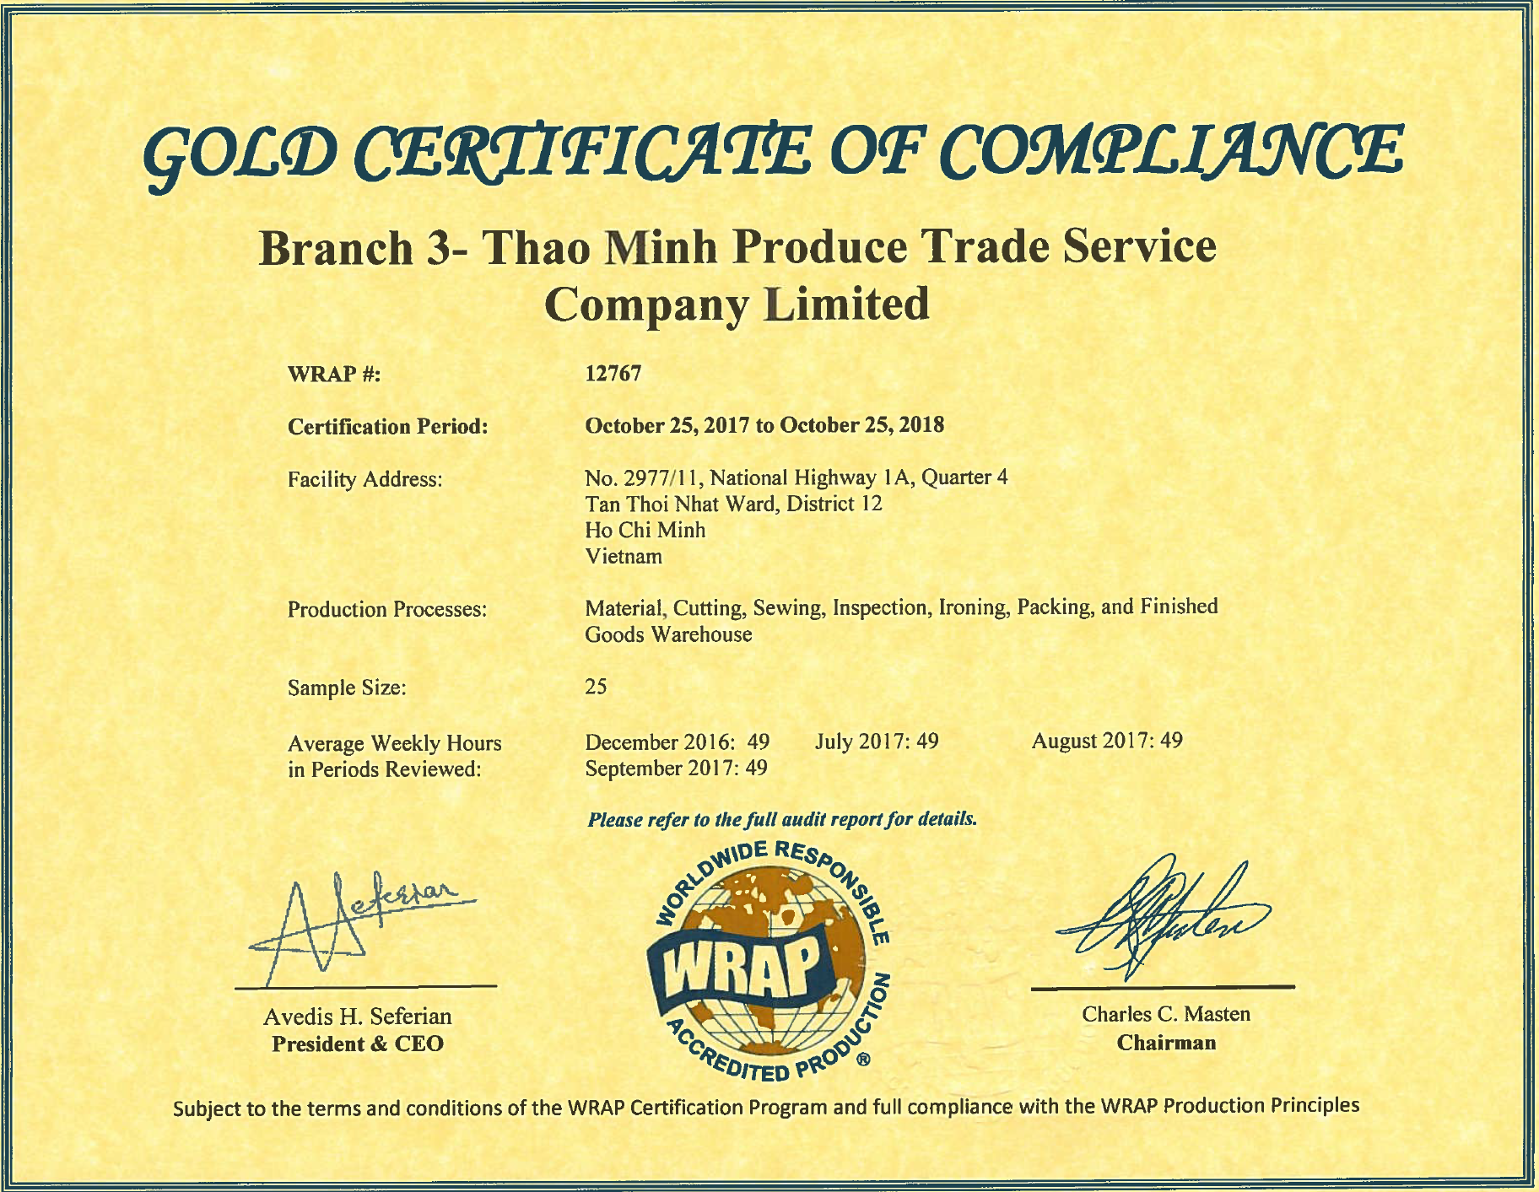
Compliances

Slide 11
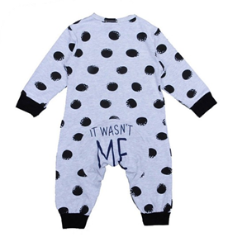
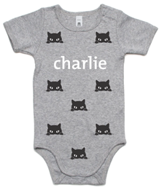
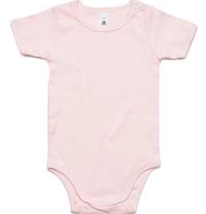
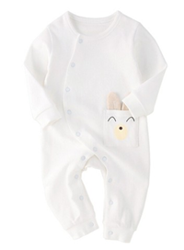
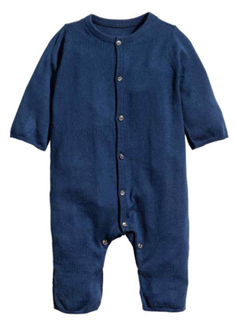
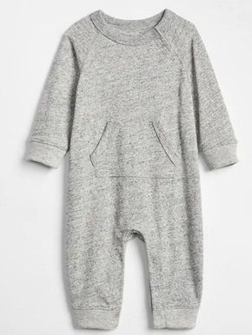
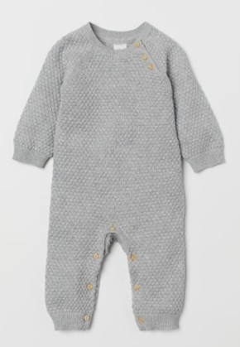
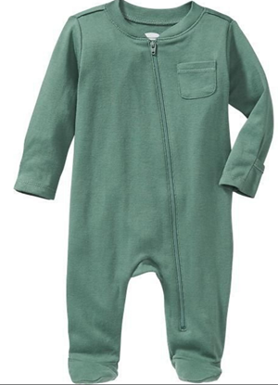

Slide 14
Products

Slide 17
Products

Slide 19
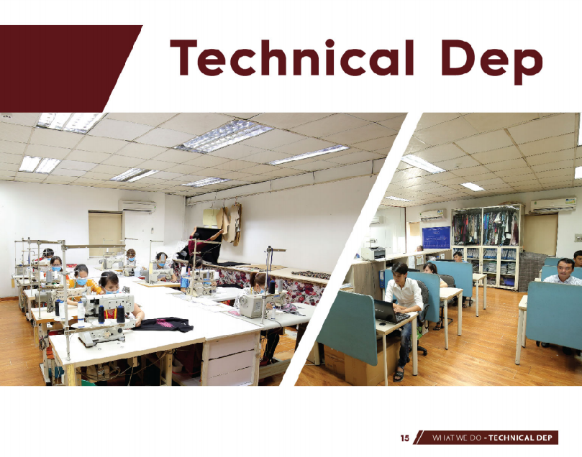

Slide 21
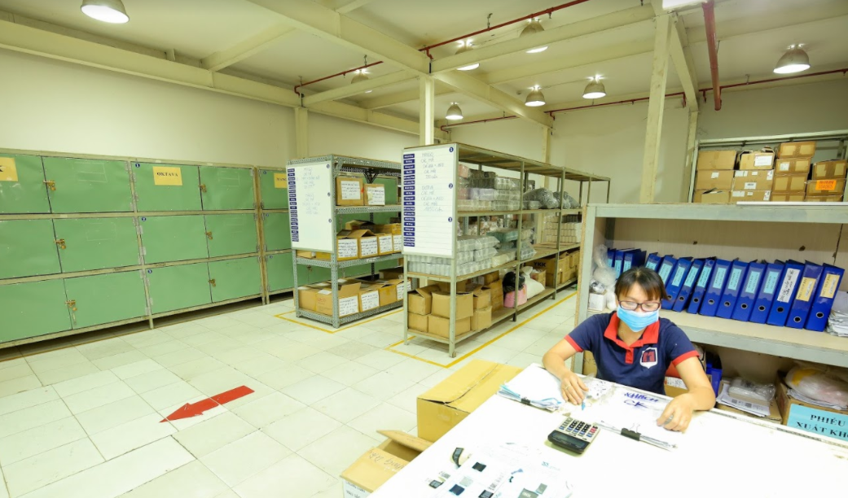

Slide 22
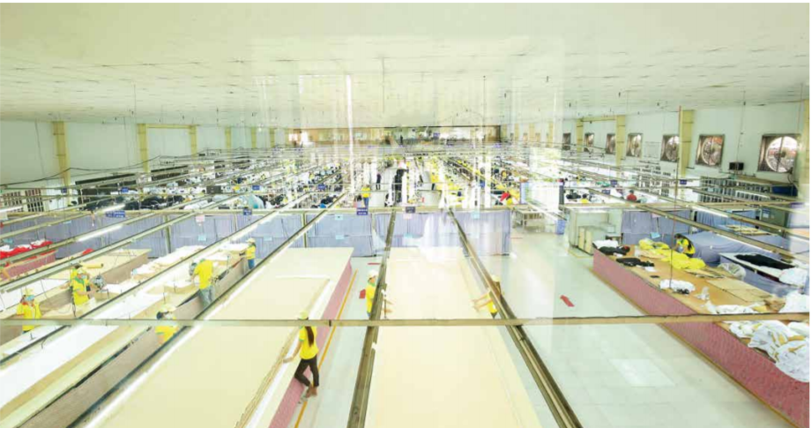

Slide 23
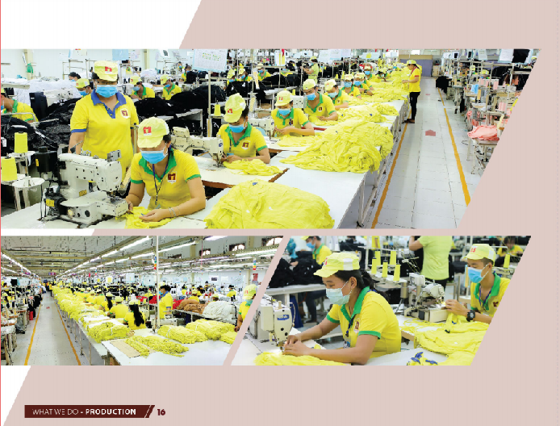
Sewing lines

Slide 24
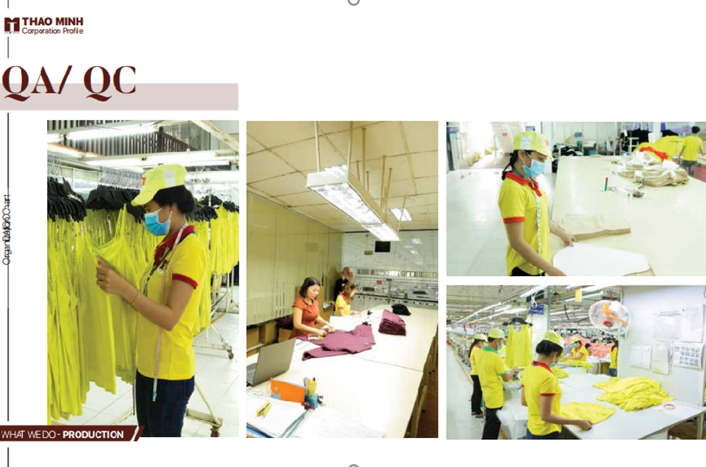

Slide 25
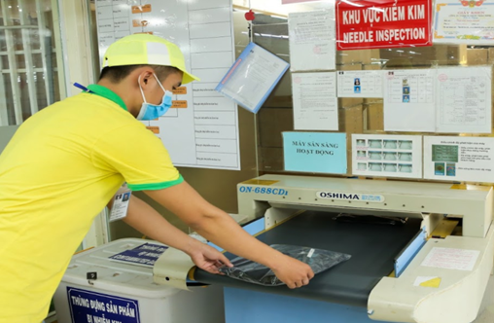

Slide 26
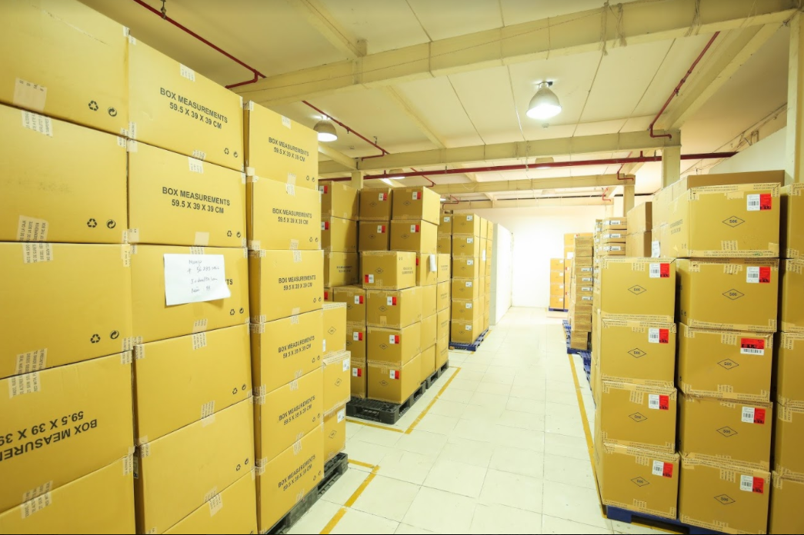

Slide 27
STRATEGY
Expand more key activities
Improve the current productivity
Build new factory in Zone 2 or 3
Reduce cost pressure for customer

Slide 28
STRATEGY
Invest more auto equipment
Train workers
Improve the current productivity

Slide 29
STRATEGY
Current activities
Expand activities
Production
Purchasing
Quality control
Development
Sourcing materials
Logistic
Expend more key activities

Slide 30
STRATEGY
Why do we choose Zone 2 or 3?
Residential population => low turnover rate
Young population
Incentive policies for manufacturers
Build new factory in Zone 2 or 2

Slide 31
Thao Minh factory 3
Address : Chau Thanh – Ben Tre province
Factory land : 20,000 square meters
Total factory size: 20 lines
Workers estimated : 1000
Stage 1 : 10 lines start to work from Oct 2020
Stage 2 : 10 lines start to work from March - April 2021

Slide 32
THANK YOU

